Slide 1


SCHOOL OF INFORMATICS DEPARTMENT OF COMPUTER SCIENCE
INTELLIGENT VOICE ASSISTANT
Presenting by:
K. Ranga Sai
Course instructor:
Dr. V Harsha Shastri
1

Slide 2
CONTENTS
01
ABSTRACT
06
PROJECT DESIG
02
INTRODUCTION
07
PROJECT IMPLEMENTATION
03
LITERATURE REVIEW
08
PROJECT RESULT
04
RESEARCH METHODOLOGY
09
FUTURE SCOPE
05
PROJECT REQUIREMENTS
09
CONCLUSION
2

Slide 3
ABSTRACT
This project presents an intelligent voice assistant developed using Python, leveraging natural language processing (NLP) and machine learning techniques.
The assistant can perform tasks such as fetching news, providing weather updates, managing schedules, opening applications, and engaging in basic conversations.
Key features include voice recognition, text-to-speech conversion, and integration with external APIs for real-time data.
The goal is to create an python demonstrate a user-friendly, interactive assistant capable of enhancing productivity and user experience.
3

Slide 4
INTRODUCTION
Voice assistants are becoming integral to modern technology, aiding in daily tasks and improving efficiency.
This project aims to design a customizable voice assistant tailored for academic and personal use.
Built using Python, it integrates libraries like pyttsx3 for text-to-speech, speech_recognition for voice input, and tensorflow for NLP.
Motivation: To explore AI-driven solutions and provide a practical tool for students and professionals.
4

Slide 5
LITERATURE REVIEW
https://www.researchgate.net/publication/341162049_Population-Specific_Genetic_and_Expression_Differentiation_in_Europeans
Speech Recognition using Deep Learning: A Survey
This paper reviews various deep learning approaches for speech recognition, highlighting advancements and challenges in the field.
https://ieeexplore.ieee.org/document/9443964
A Comprehensive Review on Intent Recognition for Voice Assistants
The study examines different techniques for intent recognition in voice assistants, focusing on the effectiveness of various machine learning models.
https://aclanthology.org/D19-1057.pdf
NLP Techniques for Building Conversational Agents: A Survey
This paper surveys natural language processing techniques essential for developing conversational agents, discussing their applications and future directions.
5

Slide 6
LITERATURE REVIEW
https://dl.acm.org/doi/abs/10.1145/3487360.3487428
Designing a Voice Assistant for Interactive Learning Experiences
The research explores the design and implementation of a voice assistant aimed at enhancing user engagement and learning in educational contexts.
https://www.sciencedirect.com/science/article/abs/pii/S1877050918305348
APIs: Important Architectural Decisions in Music Assistant Design
This paper discusses the crucial architectural decisions involved in the design of music assistants, emphasizing the role of APIs in functionality and user experience.
5

Slide 7

Research Methodology
EXISTING METHODOLOGY
PROPOSED METHODOLOGY
6

Slide 8
EXISTING METHODOLOGY
Basic Voice Recognition: Uses old technology that relies on fixed models to understand spoken words. Struggles with different accents and requires a lot of training data.
Rule-Based Assistants: Follows a strict set of commands. Responds only if a known command is used, making them less flexible.
Simple Machine Learning: Uses basic techniques to recognize user intents but struggles with complex or unclear requests.
Using Predefined APIs: Relies on outside services (like Google Assistant API) for tasks, limiting customization options.
7

Slide 9
PROPOSED METHODOLOGY
Advanced NLP Model: Utilizes deep learning tools like TensorFlow and Keras to create a powerful model that understands complex user questions.
Better Understanding of Context: Allows the assistant to track conversation and better understand user intent.
Quick Responses: Designed for real-time listening and responding, making interactions fast.w
Learning from Users: Features that let the assistant learn from interactions, improving its responses over time.
User-Friendly Interface: Simple interface that shows ongoing conversations for better user clarity.
Connecting to External Data: Accesses external services (like weather or news) while performing tasks independently.
8

Slide 10
PROJECT REQUIREMENTS
Hardware: Microphone-enabled device, speakers/headphones, and a computer with internet access.
Software:
>> Python 3.x
>> Libraries: pyttsx3, speech_recognition, tensorflow, tkinter, requests, etc.
>> Pre-trained NLP model (chat_model.h5) and tokenizer files.
APIs: NewsAPI key, OpenWeatherMap key.
Environment: Windows OS (for SAPI5 voice engine compatibility).
9

Slide 11
Project Design
FLOW CHART
11

Slide 12
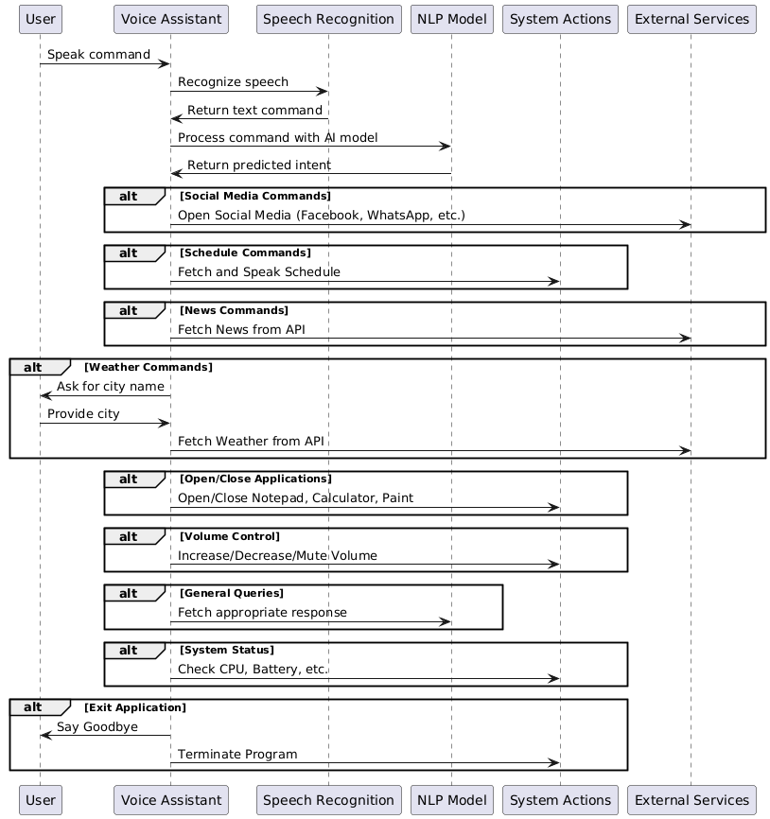
Project Design
UML DIAGRAM
10

Slide 13
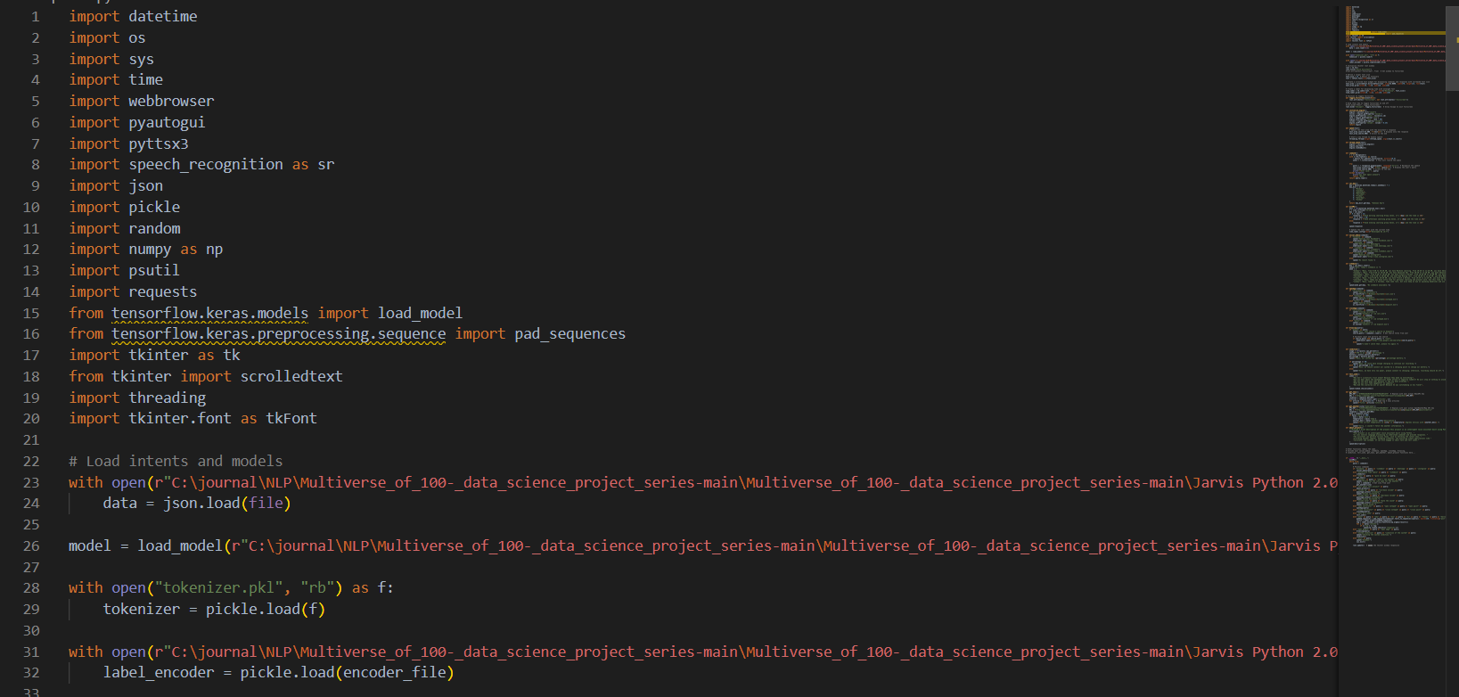
Project Implementation
1. Initialization
Load necessary libraries and modules.
Initialize the Tkinter window for the voice assistant interface.
Load pre-trained models and tokenizer for NLP functions.
12

Slide 14
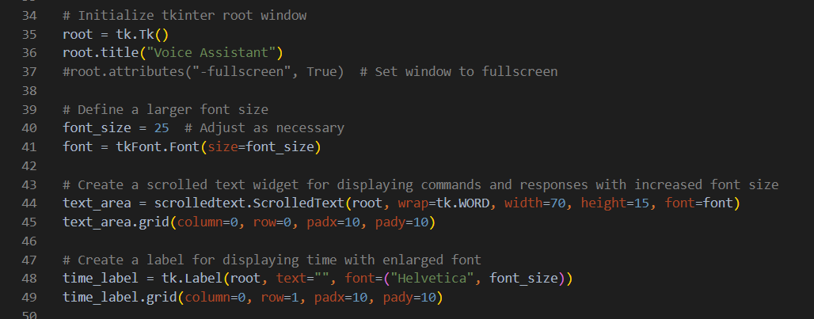
Project Implementation
2. User Interface Setup
Create a simple user interface with a text area to display conversation and a label for the current time.
Bind keyboard events for functionality, including a fullscreen toggle.
13

Slide 15
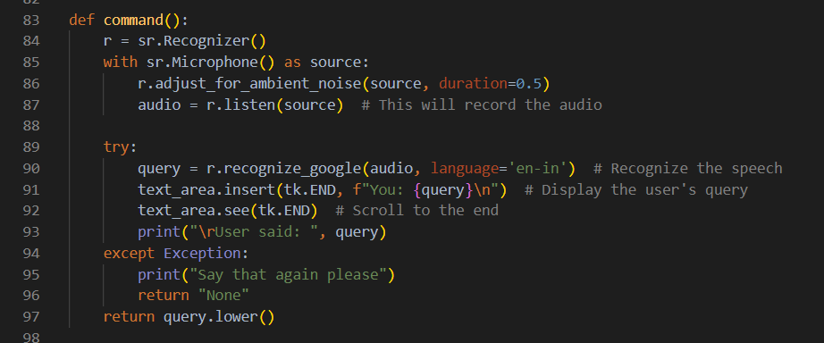
Project Implementation
3. Speech Recognition
Utilize the SpeechRecognition library to capture and interpret user voice commands.
14

Slide 16
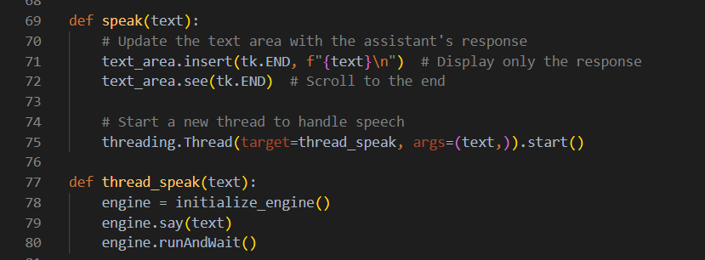
Project Implementation
4. Text-to-Speech Functionality
Use the pyttsx3 library to allow the assistant to speak responses.
15

Slide 17
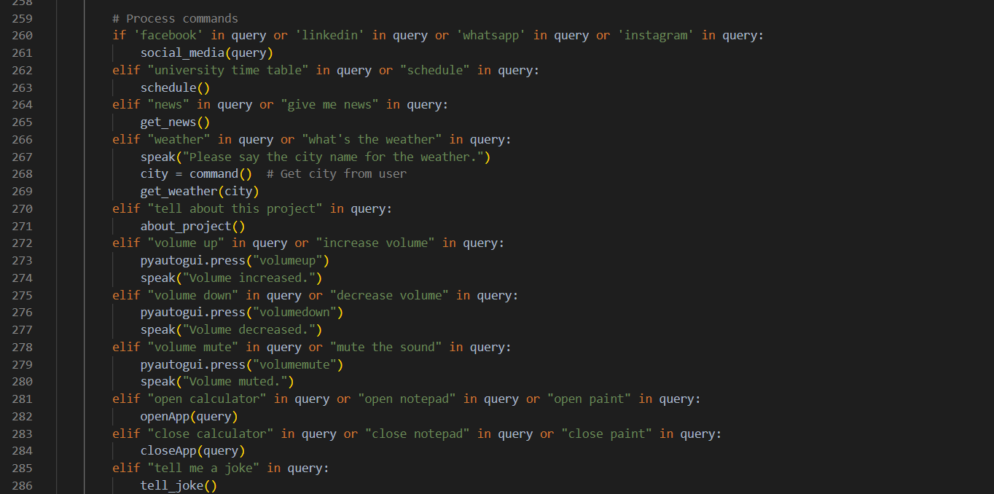
Project Implementation
5. Command Processing
Identify user queries to execute specific tasks, such as accessing social media, providing schedules, and fetching news.
16

Slide 18
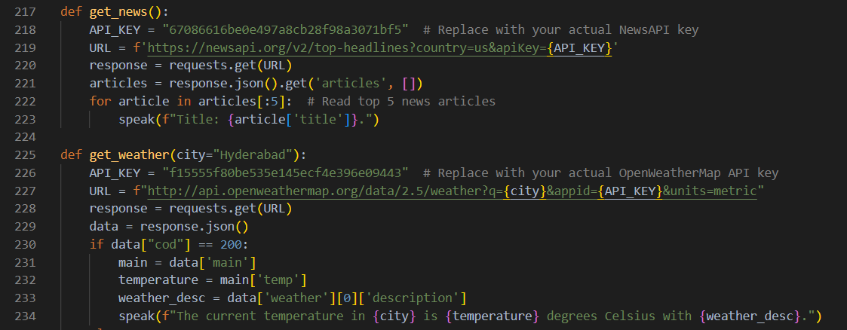
Project Implementation
6. Fetching External Data
Implement functions to retrieve weather information and news via API calls.
17

Slide 19
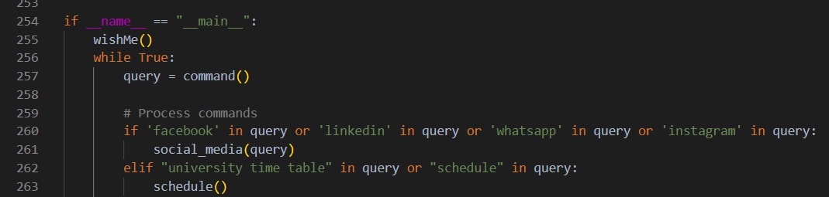
Project Implementation
7. Main Loop and Execution
Keep the application running, continuously listening for user commands and responding appropriately.
18

Slide 20
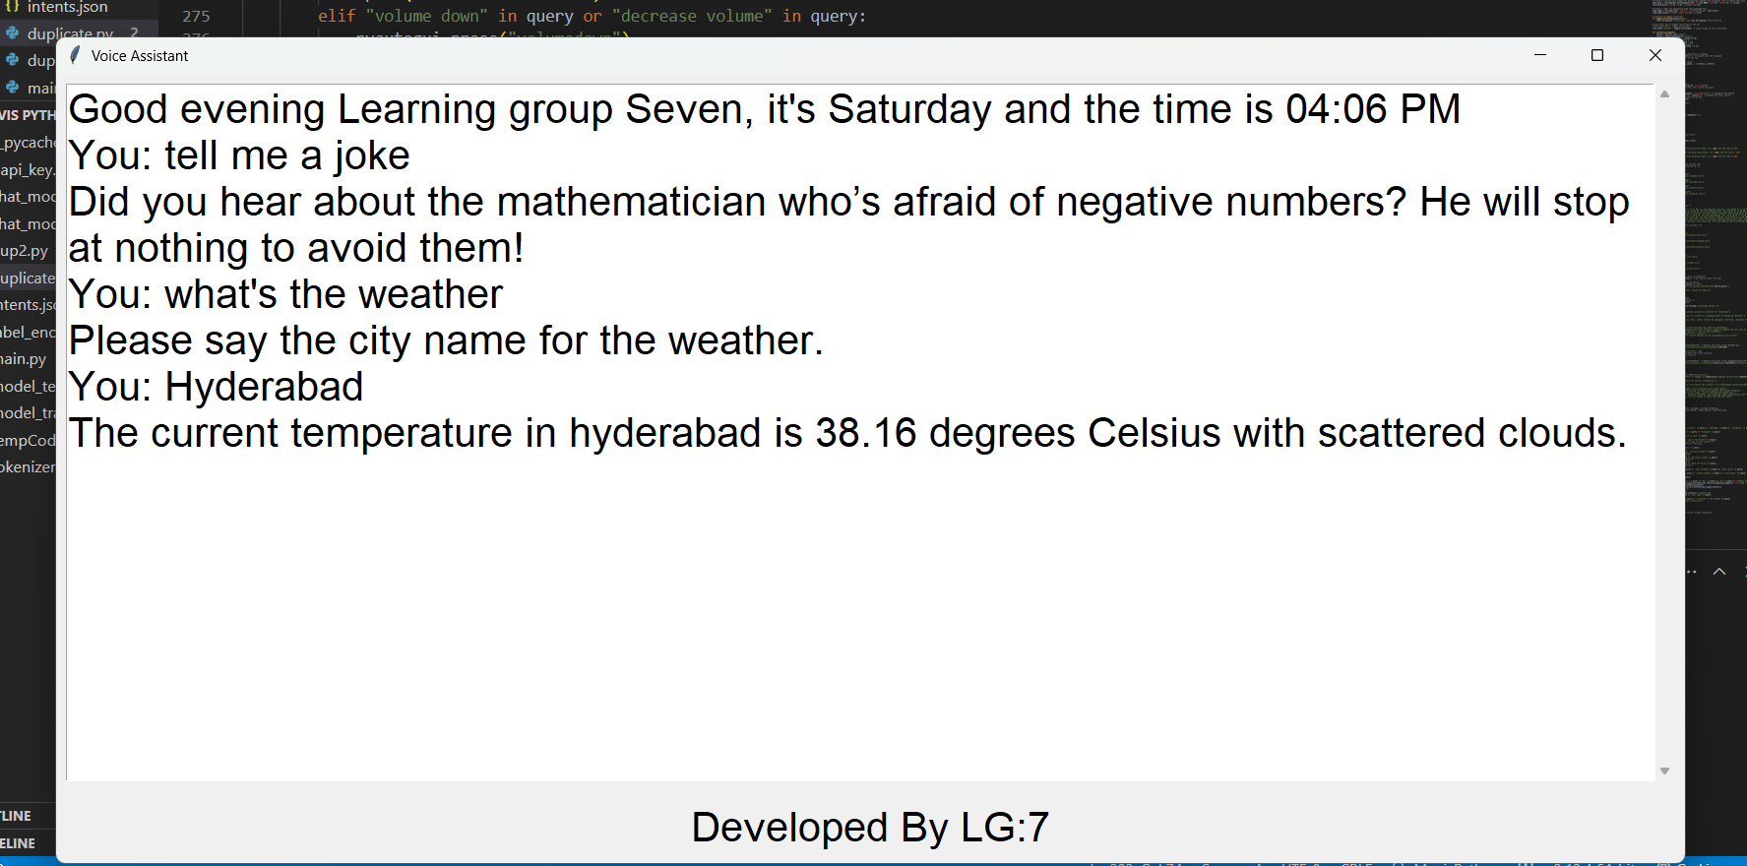
Project Result
Successfully built a voice assistant capable of:
Responding to queries (e.g., "tell me a joke", "what's the weather").
19

Slide 21
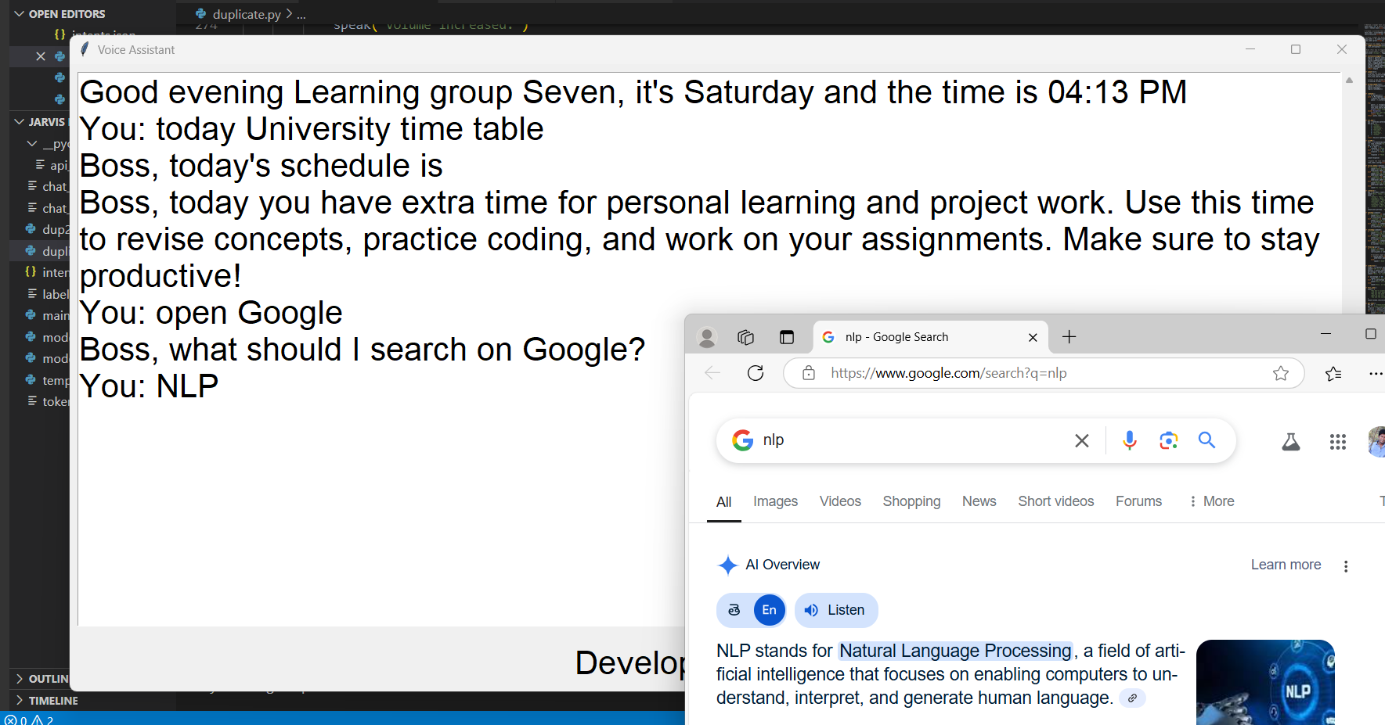
Project Result
Managing schedules and opening applications.
20

Slide 22
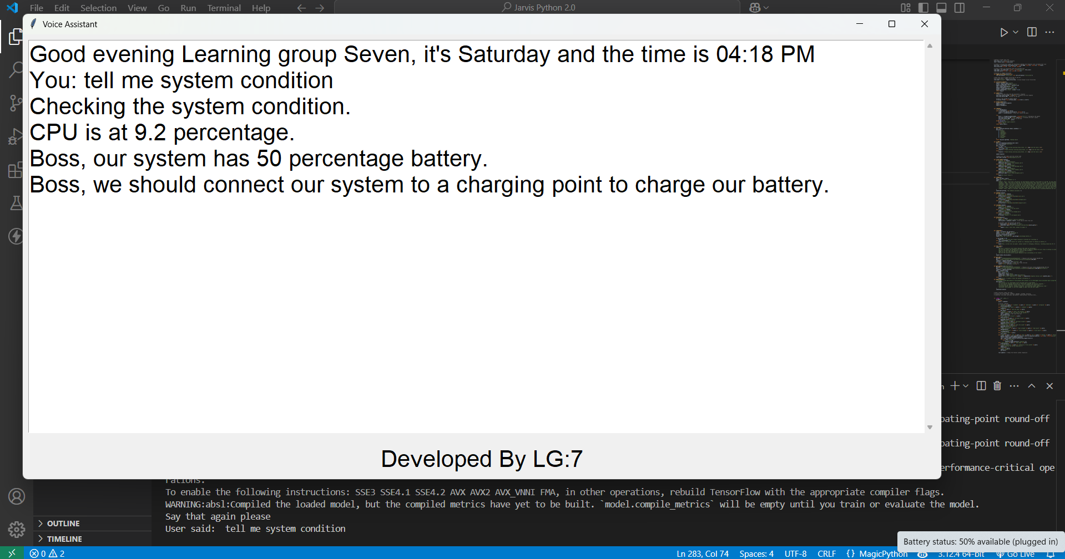
Project Result
Displaying responses in a GUI and monitoring system conditions.
21

Slide 23
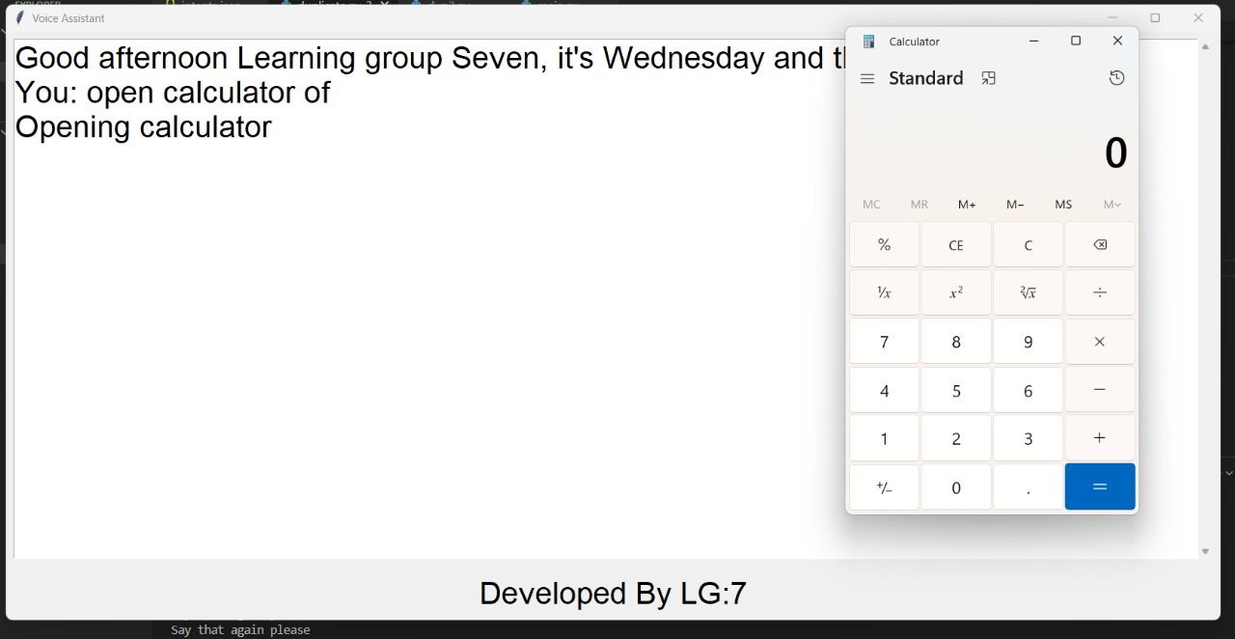
Project Result
By giving command as open calculator displaying that calculator.
21

Slide 24
Project Result
Performance:
Speech recognition accuracy: ~85% in quiet environments.
Response time: <2 seconds for most commands.
22

Slide 25
Conclusion
The project demonstrates the feasibility of creating a lightweight, feature-rich voice assistant using Python.
It bridges academic needs (e.g., timetable management) with general utility (e.g., news, weather).
Limitations include dependency on internet connectivity and occasional speech recognition errors in noisy settings.
Achieved the goal of enhancing productivity through an AI-driven tool.
23

Slide 26
Future Scope
Enhancements:
Add multilingual support for broader accessibility.
Integrate with mobile devices or cloud platforms.
Improve NLP model with larger datasets for better accuracy.
Applications: Extend to smart home control or educational tutoring systems.
Research: Explore real-time learning capabilities to adapt to user preferences over time.
24

Slide 27

Thank You
25

